Slide 1
Instructions:
To include your logo:
On each slide click on the image icon in the placeholder box.
Select your image and select open.
Select the Crop dropdown at the top right of the navigation bar under Picture Format.
Select Fit from the dropdown options.
Scale and position your logo as required.
To delete slides:
When your design is complete, select this slide and every other slide you don’t want to keep and click Delete on your keyboard.
To save and export your document as an image:
Select File at the top left of the navigation bar.
Select Save. Save your file to where you would like it located.
Again, select File at the top left of the navigation bar.
Select Export from the options that appear.
Select Change File Type.
Select PNG or JPEG from the options that appear. Then select Save As.
Navigate to where you want your logo saved and select the file and select save.
Slides 20 – 27 can be used as a presentation explaining what is International Day of People of Disability.

Slide 2

Presentation Title
Presentation Subtitle

Slide 3


Slide Title
Body text

Slide 4

Slide Title

Slide 5

Slide Title
Body text
Body text

Slide 6
Slide Title
Body text

Slide 7


Slide 8

Presentation Title
Presentation Subtitle

Slide 9

Slide Title
Body text

Slide 10
Slide Title

Slide 11

Slide Title
Body text
Body text

Slide 12
Slide Title
Body text

Slide 14

Presentation Title
Presentation Subtitle

Slide 15

Slide Title
Body text

Slide 16
Slide Title

Slide 17

Slide Title
Body text
Body text

Slide 18
Slide Title
Body text

Slide 20

Presentation Title
Presentation Subtitle

Slide 21
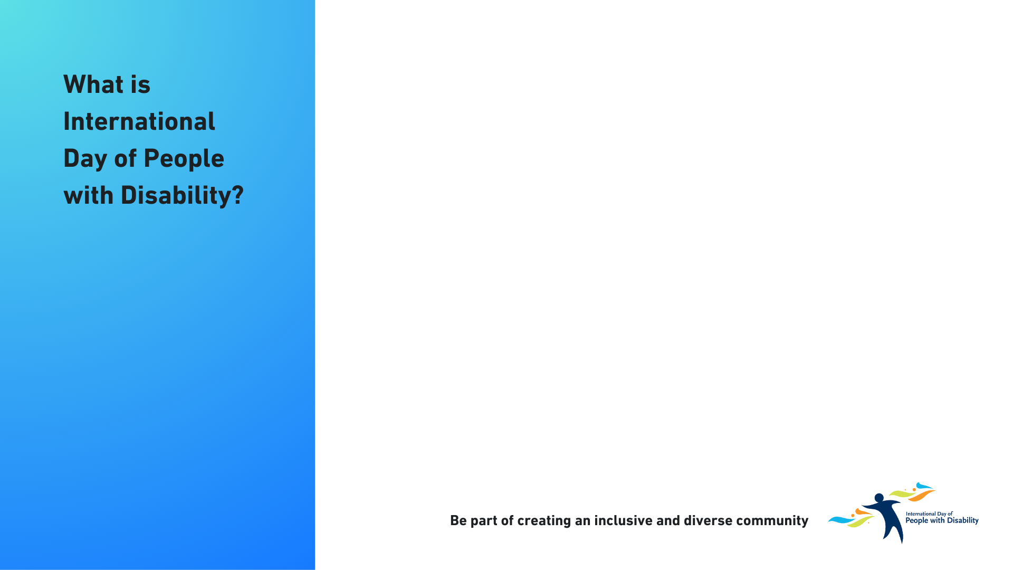
International Day of People with Disability (IDPwD) is a United Nations (UN) observed day recognised on 3 December each year. The aim of IDPwD is to raise awareness, understanding and acceptance of the 5.5 million people with disability in Australia.
In 1992, the UN declared 3 December as International Day of Disabled Persons. Each year the UN announces a theme that gives a focus for society to remove barriers for people with disability and become more inclusive.
In Australia, IDPwD is a joint effort between government, schools, organisations, community groups, businesses and individuals.
The Australian Government has been supporting IDPwD since 1996. Through the Department of Social Services, it promotes and raises awareness of IDPwD on 3 December and throughout the year.

Slide 22


Slide 23
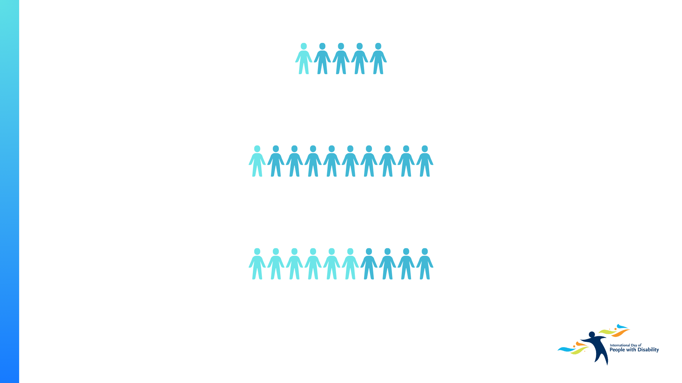
5.5 million people with disability live in Australia – that’s 1 in 5 people.
1 in 10 people with disability have experienced discrimination.
More than half of all older persons in Australia live with disability.
Source: Disability, Ageing and Carers,
Australia survey 2022, Australian Bureau
of Statistics www.abs.gov.au/disability

Slide 24
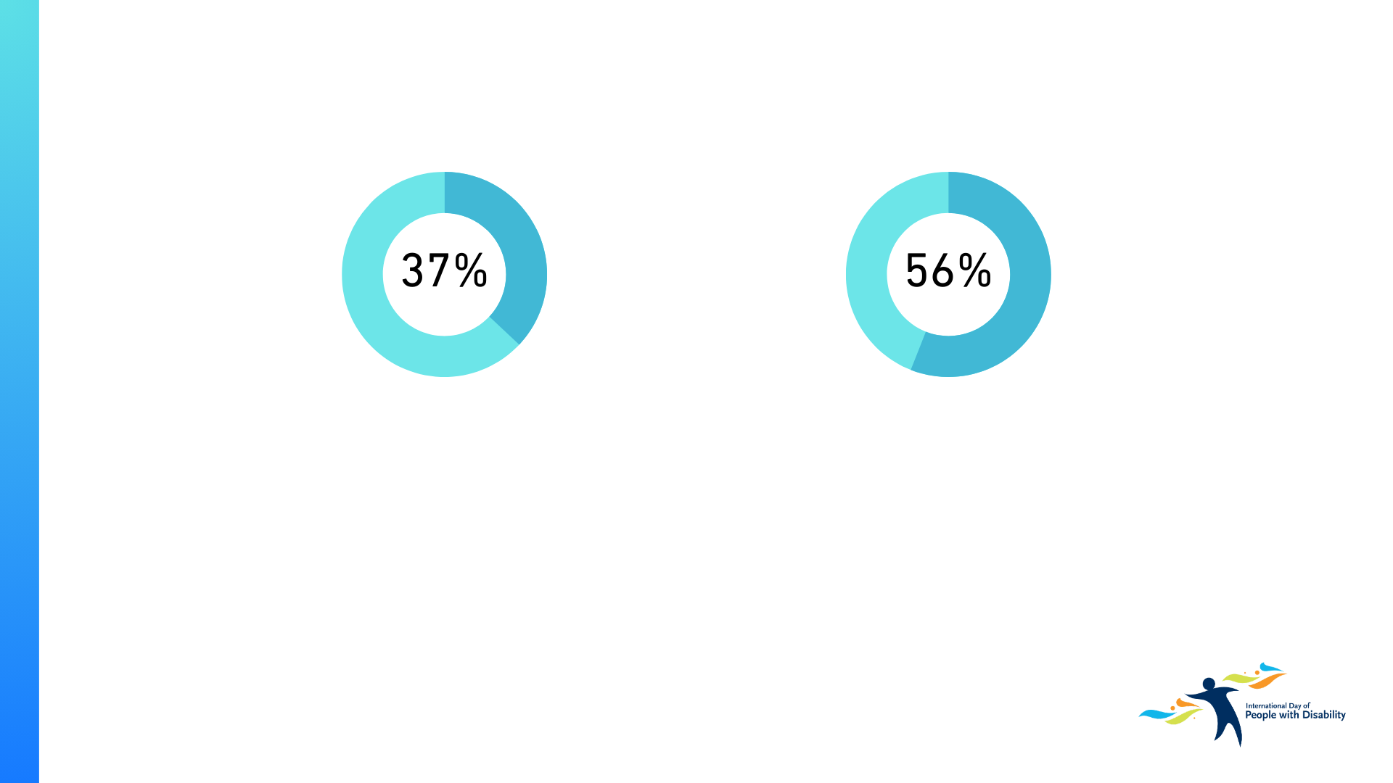
Around 1 in 3 people with disability have severe or profound disability.
56% of people with disability aged 15-64 have a job.
Source: Disability, Ageing and Carers,
Australia survey 2022, Australian Bureau
of Statistics www.abs.gov.au/disability

Slide 25

Organise an IDPwD event
You can break down barriers and promote inclusiveness by encouraging your school, workplace, or community group to organise an IDPwD event on or around 3 December.
You can find resources on our website to help you organise your IDPwD event.
Take part in an IDPwD event
Connect with your local community including people with disability, their families and carers by taking part in an IDPwD event on or around 3 December.
You can find IDPwD events in your local area via the events calendar on our website.
Take action
IDPwD is a good time to make a commitment within your organisation, workplace or community group to:
develop a new disability action plan
support a local disability organisation
encourage conversations in your community, school, workplace, or with family and friends about disability inclusion and accessibility.

Slide 26

Read, watch or listen
Not all disability is the same and everyone’s experience is different. Learning more about people with disability can help us all reflect on our attitudes and beliefs.
You can find stories from the disability community via the Stories page on our website.
Share your own story
If you are a person with lived experience of disability, you may wish to share your own story about your personal experiences, achievements or challenges.
You can share your story on our website.
Help spread the word
Social media is a great way to raise awareness and show your support for IDPwD.
We encourage you to share messages of inclusion and diversity on your networks.
For social media key messages, posts and graphics visit our website.

Slide 27


