Slide 1
Before you use this template
Please delete this slide before your session.
For facilitators: adapt this presentation for your community.
Make it local
Plan the yarn
Include everyone
Replace the bracketed fields. Add local stories, contacts and slides. Keep the IDPwD logo.
Read the notes below each slide for guidance. Choose the topics and questions that suit your group.
Ask about access needs and local protocols. Let people listen, pass or take a break.
If planning to send a copy of the presentation to anyone, check web accessibility.
Open Notes below for more guidance on how to adapt the presentation and run a session.
Notes:
This setup slide is for the facilitator. Begin the session with the cover and Acknowledgement of Country.
Adapt for local use
Save a copy before editing. Replace bracketed text and use Home > New Slide to choose a named layout.
Add your own content and slides. Duplicate a suitable slide to keep its design. Hide or remove slides you do not need.
Keep the International Day of People with Disability (IDPwD) logo. An optional logo placeholder beside it is provided on the cover. Use Insert Picture and Crop > Fit so the whole logo is visible. Remove the empty placeholder if not needed.
Read these notes using the Notes button beneath the slide. Delete this setup slide before presenting.
If planning to send a copy of the presentation to anyone, please check web accessibility
To run web accessibility checks, use Review > Check Accessibility.
Check reading order, add meaningful image descriptions in Alt text or mark as decorative as required, text contrast and that all text fits.
These tips are not relevant if only presenting and speaking.
Facilitation tips
Plan with people with disability and seek local cultural guidance. Ask about access needs before the session.
After editing, run Review > Check Accessibility. Check reading order, meaningful image descriptions, text contrast and that all text fits.
Keep questions short. People may listen, pass, take a break or contribute another way.

Slide 2
Community
Yarning
Session
[Community or organisation]
[Date and place]
Notes:
Adapt for local use
Replace the community or organisation, date and place fields.
Keep the IDPwD logo. Use the optional picture placeholder beside it for your organisation’s logo, with permission. Do not stretch either logo.
Use the first setup slide before planning. Add, remove or duplicate slides to suit the local yarn.
Suggested talking points
Welcome, everyone. My name is [name]. Thank you for joining our community yarning session.
The First Nations Yarning Guide supports local conversations about disability, inclusion and cultural safety.
Facilitation tips
Invite people with disability to help plan or lead the session. Check access needs and local protocols.
People may listen, pass, take a break or contribute in another way.
Explain how notes will be used. Seek permission before if recording.

Slide 3
Acknowledgement of Country
[Add your community’s Acknowledgement of Country here]
Notes:
Adapt for local use
Adapt the acknowledgement to your organisation and the local Traditional Owners, with appropriate advice.
An Acknowledgement of Country does not replace a Welcome to Country.
Replace the bracketed acknowledgement on the slide with your locally agreed statement.
Suggested talking points
[Your locally agreed Acknowledgement of Country]
Facilitation tips
Follow local cultural protocols. Do not assume that photographed people are the people sharing stories in this session.

Slide 4
International Day of People with Disability (IDPwD)
3
A day for understanding and inclusion
An opportunity to talk about disability and how we can have these yarns in community.
December
Every year
Notes:
Adapt for local use
Add a local example of International Day of People with Disability (IDPwD), if relevant.
Suggested talking points
International Day of People with Disability takes place on 3 December each year.
Today we recognise the diverse experiences and contributions of people with disability.
This day gives us an opportunity to listen, learn and think about how we can make our community more inclusive.
Facilitation tips
Introduce the full name before using IDPwD or you can say ‘the day’ or ‘day of people with disability’.
Invite people to share what they already know.
Resources
International Day of People with Disability website

Slide 5
Yarning about IDPwD
Our experience
Our community
Have you heard of International Day of People with Disability?
How can we build understanding and acceptance of disability in our communities?
Notes:
Adapt for local use
Choose or adapt the questions for your community. You do not need to use every prompt.
Suggested talking points
What is everyone’s experience of IDPwD? Does anyone have any examples of being involved?
What could understanding and acceptance look like in everyday community life?
Facilitation tips
Read one question at a time and allow thinking time.
Listening without speaking is welcome.

Slide 6
Disability in our communities
5.5 million
37%
About 1 in 5 (21.4%)
2022
About 367,700 people
2022–23
Australians living with disability
Aboriginal and Torres Strait
Islander people reporting disability
These figures come from different surveys and cannot be compared directly.
ABS SDAC 2022 and NATSIHS 2022–23.
Notes:
Adapt for local use
Keep the survey years and source references with the figures. Check the Australian Bureau of Statistics sources before updating the numbers.
Do not present the two estimates as directly comparable. The surveys have different methods and coverage.
Suggested talking points
In 2022, 5.5 million Australians, or 21.4%, had disability. This is about 1 in 5 people.
The 2022–23 Aboriginal and Torres Strait Islander health survey reported disability for 37%, about 367,700 people.
The circles show different groups and are not intended to be compared.
Facilitation tips
Keep the focus on people, inclusion and support.
Read the numbers aloud and explain them in plain language.
Do not ask anyone to disclose disability or personal health information.
Sources
Australian Bureau of Statistics: Disability, Ageing and Carers, Australia — Summary of Findings, 2022
Australian Bureau of Statistics: National Aboriginal and Torres Strait Islander Health Survey, 2022–23

Slide 7
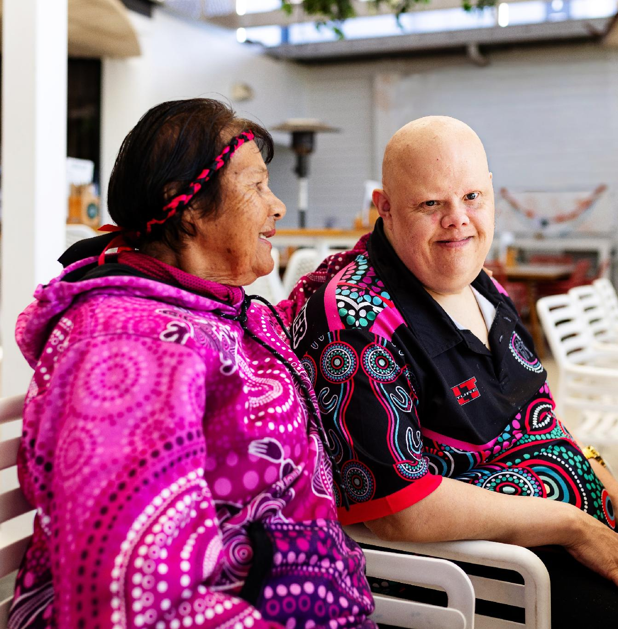
Different experiences of disability
Everyone’s experience is different
Disability can be physical, mental, intellectual or sensory.
Visible and hidden
Some disability is easy to see. Other disability is hidden.
Disability may be lifelong or temporary.
Experiences and support needs can change.
Notes:
Adapt for local use
Use local examples only with permission.
Suggested talking points
How can we better recognise and support the diverse, visible, and hidden experiences of disability within our community?
Facilitation tips
Avoid assumptions about what a person can do or the support they want. Ask about their preferences.
Do not ask participants to disclose a diagnosis. Continue checking in as needs change.

Slide 8
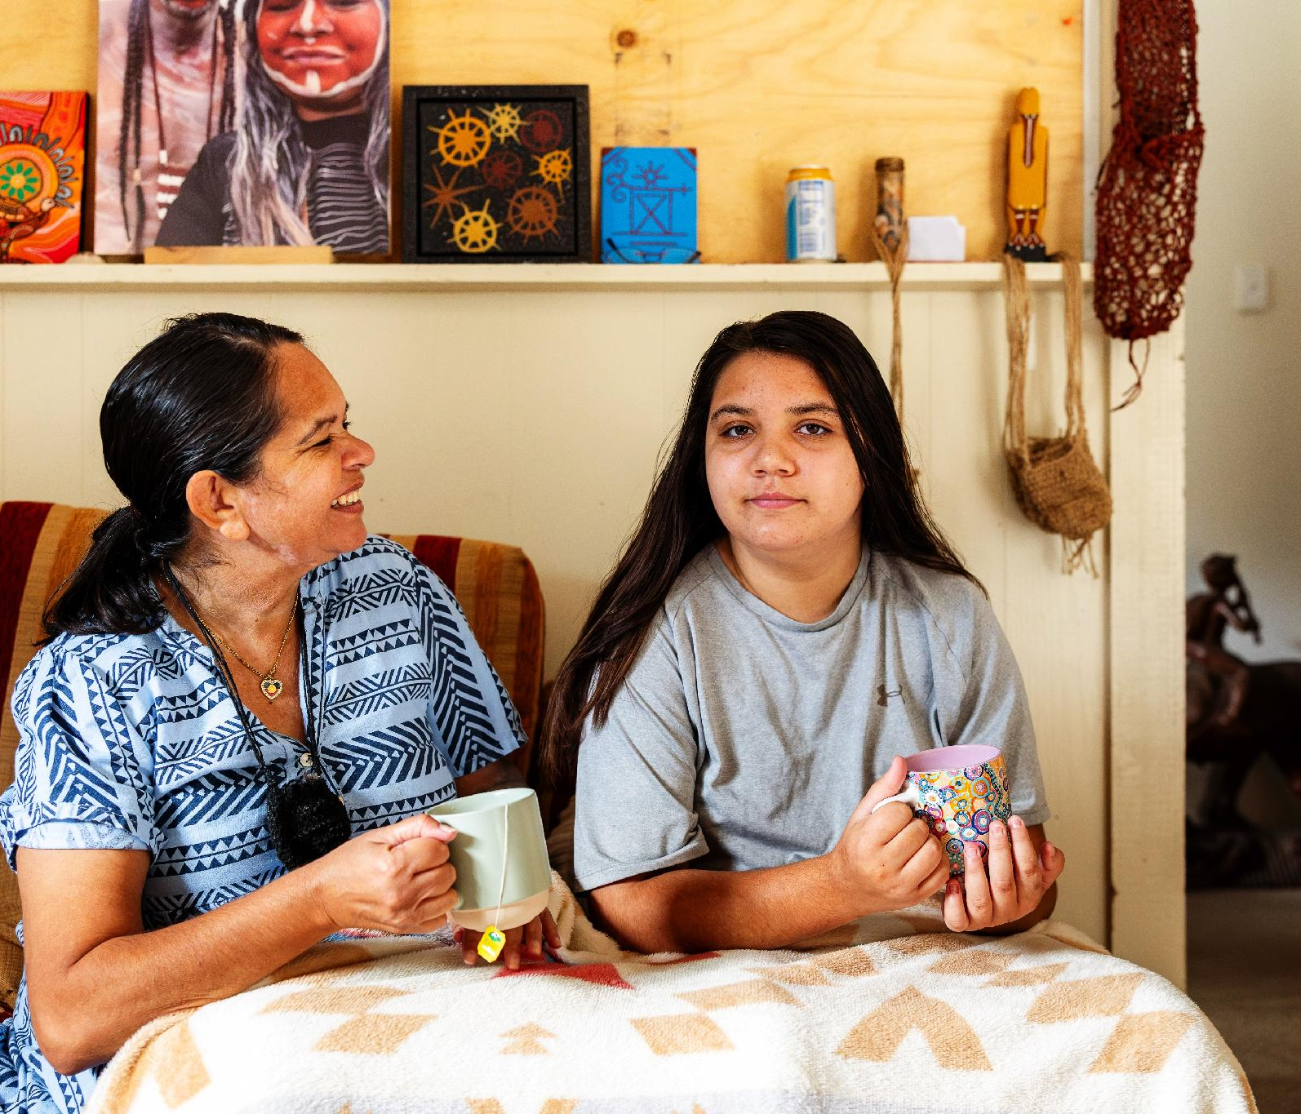
Respectful language
Words matter
The words we use affect how we see and treat people with disability.
It is okay to feel unsure
Having the conversation is important.
Be respectful and open. Listen to the person.
Notes:
Adapt for local use
Use this slide before the questions on words, identity and belonging.
Add a local language example only with appropriate advice and permission.
Suggested talking points
The words we use matter.
Has anyone experienced a time when the language someone used made them feel respected and included?
Facilitation tips
Talk directly to the person, including when an interpreter or support person is present.
Avoid labels such as victim, sufferer or handicapped. Avoid calling someone brave or inspiring simply because they have disability.
Listen without assuming you understand the person’s experience.

Slide 9
Words, identity and belonging
Belonging
How can our understanding of disability help people feel included, respected and valued?
Language
How can words and labels have a positive or negative impact?
Community
How does community shape how people see their disability and the challenges they face?
Notes:
Adapt for local use
Use the preceding respectful language slide as an introduction.
Choose one or more questions for the yarn.
Suggested talking points
Community plays an important role in helping people feel included, valued and connected.
Does anyone have an example of when their community helped them feel supported or that they belonged?
Facilitation tips
Read one question at a time.
Use the words people prefer for themselves.
Do not ask one person to speak for everyone with disability.
Invite personal examples only if people feel comfortable.

Slide 10
Creating inclusive spaces
Ask people what helps them take part.
Physical access
Clear paths, accessible entrances and bathrooms.
Communication
Clear information and different ways to join the conversation.
Comfort and choice
Time to respond, breaks and a quiet space when needed.
Notes:
Adapt for local use
Replace the examples with locally relevant ones if useful.
Follow this slide with the inclusive community questions.
Suggested talking points
Feeling welcome starts with listening to people about what they need.
What helps you feel included and welcome in your community?
Facilitation tips
Welcome carers and support people according to the participant’s wishes.
Offer information in formats that work for participants, including screen reader users.
Read important text aloud.
Check needs throughout the session, as they can change.

Slide 11
An inclusive community
Welcome
How can our community create safe and welcoming spaces for people with disability?
Access
What can we do to make our community more inclusive and accessible?
Ongoing support
How can our community support people as their experiences and needs change?
Notes:
Adapt for local use
Use the preceding inclusive spaces slide as a prompt.
Choose questions relevant to local places and activities.
Suggested talking points
What could we change to make our community more welcoming and accessible?
What ongoing support would help people take part in community life?
Facilitation tips
Read each question aloud and allow time to respond.
Accept different ways of contributing.
Ask before noting a personal example.
Avoid promising changes that have not been agreed.

Slide 12
Sharing local stories
[Guest speaker’s preferred name]
[Short introduction approved
by the speaker]
[Key message or story
shared with permission]
Notes:
Hide or remove this slide if there is no local story.
Adapt for local use
Replace the bracketed fields with the speaker’s preferred name and approved introduction.
Add a photograph only with consent.
Agree on questions, recording and reuse beforehand.
Pay the speaker for their time and contribution.
Suggested talking points
[Speaker’s preferred name], thank you for joining us. [Approved introduction.]
You are welcome to share what you feel comfortable sharing, in the way that works best for you.
Facilitation tips
Ensure the space is accessible, culturally safe and comfortable.
Respect the speaker’s boundaries.
Offer breaks and alternative ways to share a story.
Do not pressure anyone to disclose personal information.

Slide 13
Who is in our community?
[Local organisation, service or community contact]
[Support available] [Phone, website or contact person]
[Local organisation, service or community contact]
[Support available] [Phone, website or contact person]
[Local organisation, service or community contact]
[Support available] [Phone, website or contact person]
Notes:
Adapt for local use
Replace the fields with relevant local organisations, services and community contacts.
Select a whole card to duplicate, move or delete it.
Click inside the group to edit text.
Duplicate the slide if you need more space.
Check contact details, availability, eligibility and access information.
Add logos only with permission.
Suggested talking points
Here are some local organisations, services and community contacts that may be helpful.
You can get this list [explain how].
Are these contacts useful to you?
Are there other services or networks we should add?
Facilitation tips
Offer the contact information in a format people can use.
Do not assume every service suits every participant.

Slide 14
Culture, Country and support
Elders
Culture and Country
What role do Elders play in supporting the next generation of people with disability?
How do culture and Country support the health and wellbeing of our communities?
Rural and remote access
Health professionals
What would make it easier for people in rural and remote areas to access support?
How can health professionals listen and respond to the needs of people with disability?
Notes:
Adapt for local use
Choose the prompts relevant to this community.
Seek local guidance about the role of Elders and cultural protocols.
Suggested talking points
How can connection to culture and Country support people with disability?
What role do Elders play in supporting the next generation of people with disability?
How can we listen to people with disability and support their participation in cultural and community life?
Facilitation tips
Read one prompt at a time and allow space for local knowledge.
Do not expect Elders or participants to share cultural knowledge they do not wish to share.

Slide 15
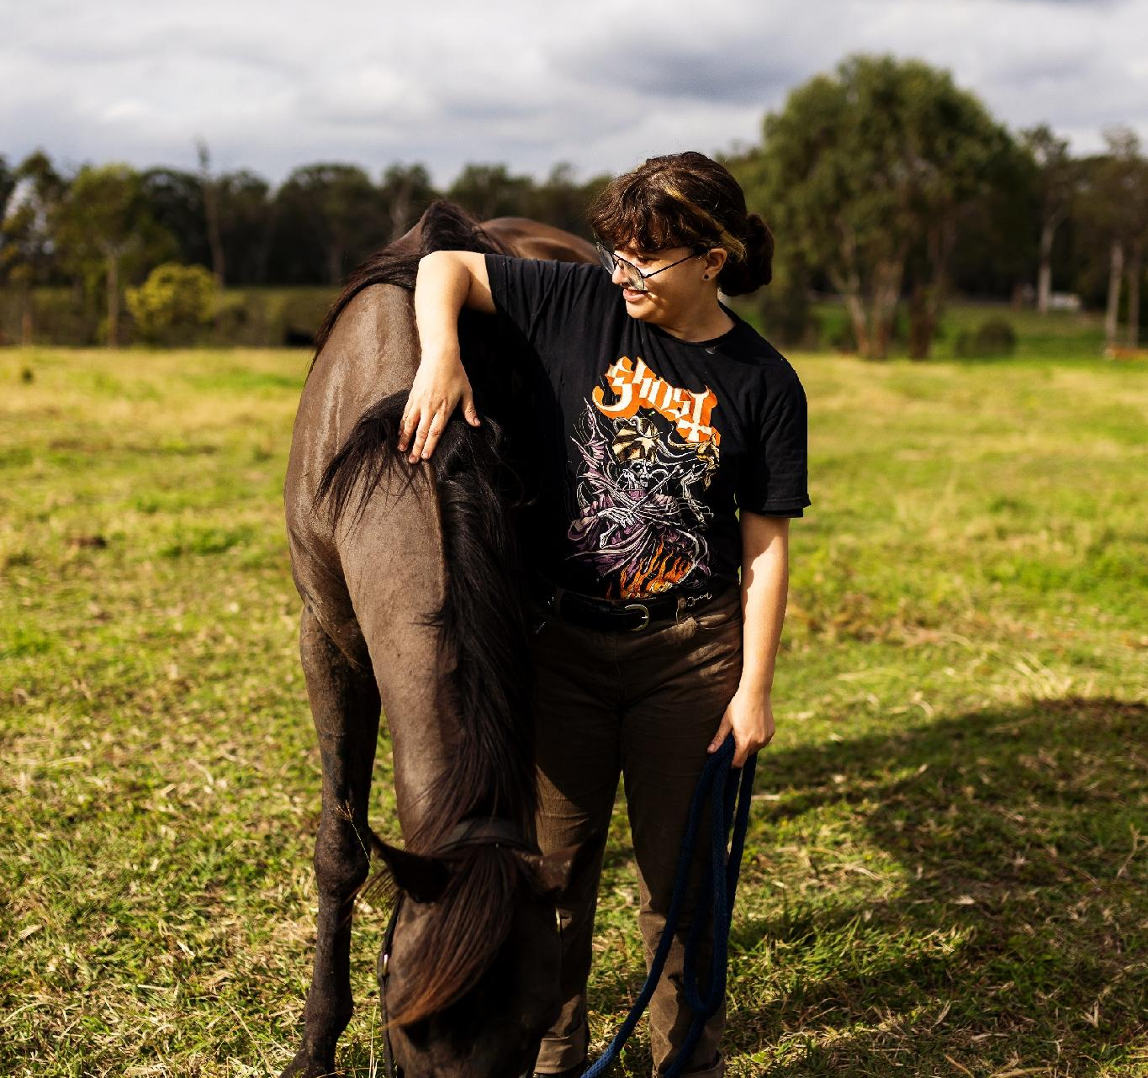
Continuing the conversation
Learning to be more inclusive
Learning to be more inclusive is a journey. Conversations about disability can help us build communities that are more accessible and respectful.
IDPwD Yarning Guide: www.idpwd.gov.au/yarning-guide
Notes:
Adapt for local use
Add any agreed local actions and a contact for follow-up.
Replace the photograph only with permission.
Suggested talking points
Thank you for your time and contributions.
I hope we can keep this conversation going with our families, friends and colleagues.
We have agreed to [actions]. [Names or roles] will take these forward, and we will hear back through [follow-up arrangements].
The Yarning Guide offers more information to support these conversations.
Facilitation tips
Share resources in an accessible format. See instructions in the Notes on the first slide.
Offer a private way to give feedback or ask for support.
Resources
International Day of People with Disability website

Slide 16
Local websites and resources
[Website or resource name]
[What it offers] [Short URL]
[Website or resource name]
[What it offers] [Short URL]
[Website or resource name]
[What it offers] [Short URL]
Notes:
Adapt for local use
This slide is optional. Delete it if you have no additional resources to share.
Replace the bracketed fields with trusted local websites or online resources. Add, duplicate or remove cards as needed.
Hyperlink each descriptive resource name to its full web address. Include a readable short URL and check each link before the session.
Keep the IDPwD logo and check spacing after editing.
Suggested talking points
Here are some local websites and resources you may find useful.
You can access this list [explain how].
Are there other resources you would like to share?
Facilitation tips
Read out the resource names and explain what they offer.
Provide an accessible copy of the links after the session. See instructions in the Notes on the first slide.
Check that participants can access the resources and offer another way to get the information if needed.

