Slide 1
Instructions:
This slideshow can be used as presentation about International Day of People of Disability. To tailor, follow these instructions or use the templates on idpwd.gov.au.
To include your logo:
On each slide click on the image icon in the placeholder box.
Select your image and select open.
Select the Crop dropdown at the top right of the navigation bar under Picture Format.
Select Fit from the dropdown options.
Scale and position your logo as required.
To add slides:
Select Home at the top left of the navigation bar.
Select New Slide and choose the available slide layouts from the drop down.
To change layout of slides:
Select Home at the top left of the navigation bar.
Select Layout and choose the available slide layouts from the drop down.

Slide 2
Learn about IDPwD
3 December

Slide 3
What is International Day of People with Disability?
International Day of People with Disability (IDPwD) is a United Nations (UN) observed day recognised on 3 December each year. The aim of IDPwD is to raise awareness, understanding and acceptance of the 5.5 million people with disability in Australia.
In 1992, the UN declared 3 December as International Day of Disabled Persons. Each year the UN announces a theme that gives a focus for society to remove barriers for people with disability and become more inclusive.
In Australia, IDPwD is a joint effort between government, schools, organisations, community groups, businesses and individuals.
The Australian Government has been supporting IDPwD since 1996. Through the Department of Health, Disability and Ageing, it promotes and raises awareness of IDPwD on 3 December and throughout the year.

Slide 4
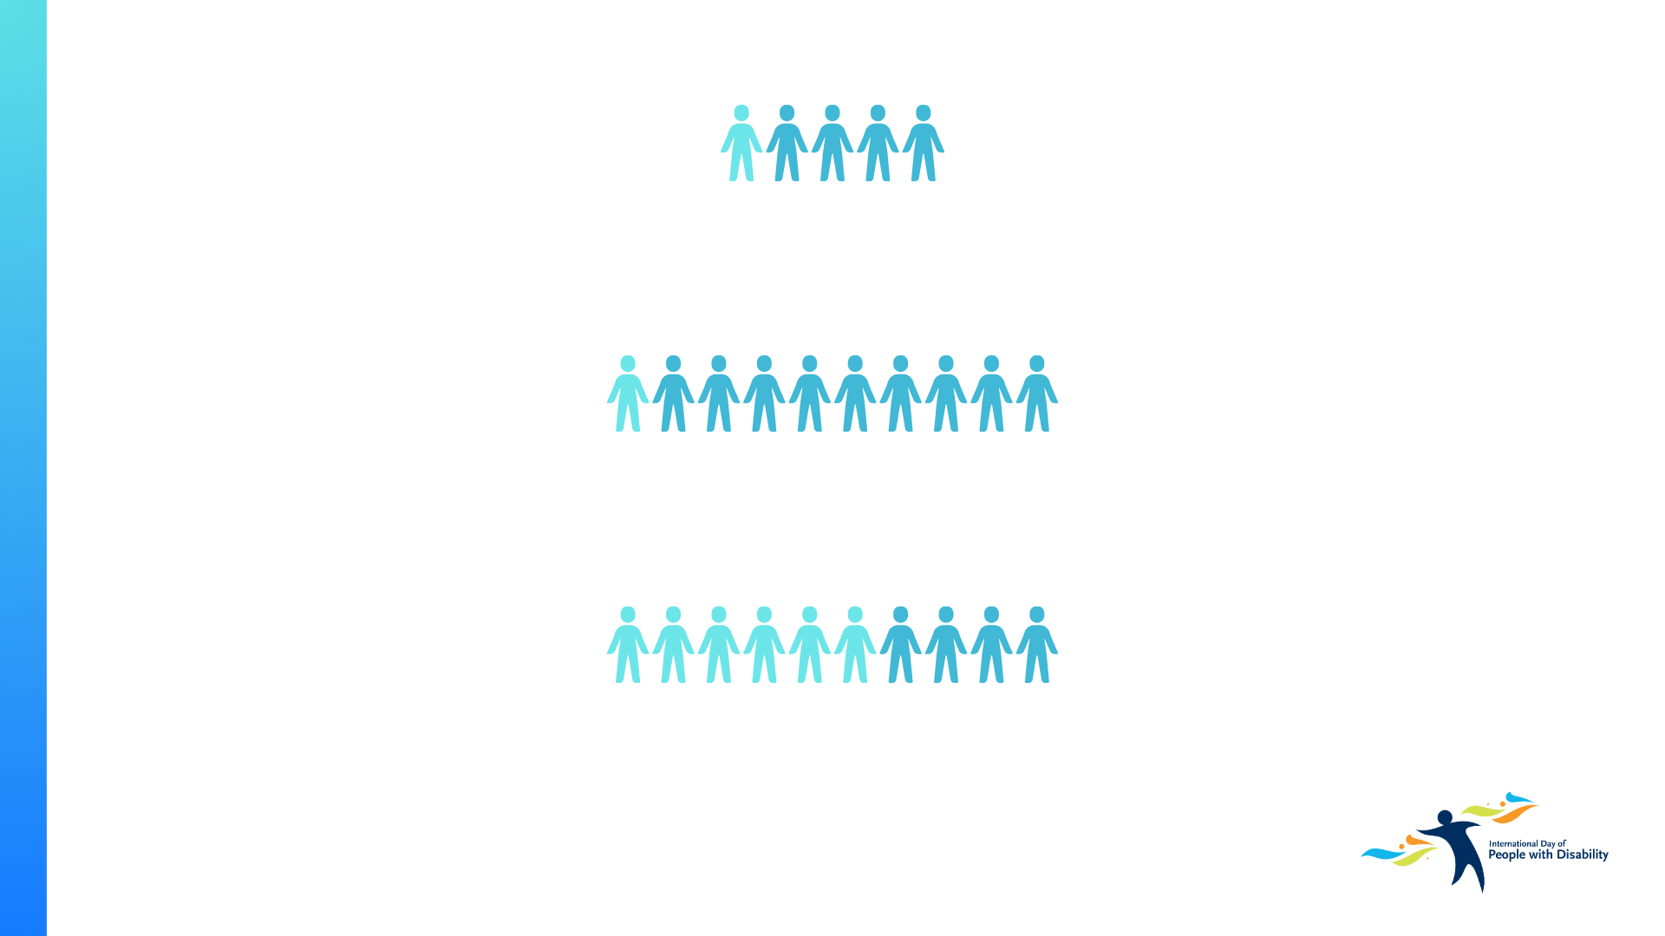
Disability in Australia
5.5 million people with disability live in Australia – that’s 1 in 5 people.
1 in 10 people with disability have experienced discrimination.
More than half of all older persons in Australia live with disability.
Source: Disability, Ageing and Carers,
Australia survey 2022, Australian Bureau
of Statistics www.abs.gov.au/disability

Slide 5
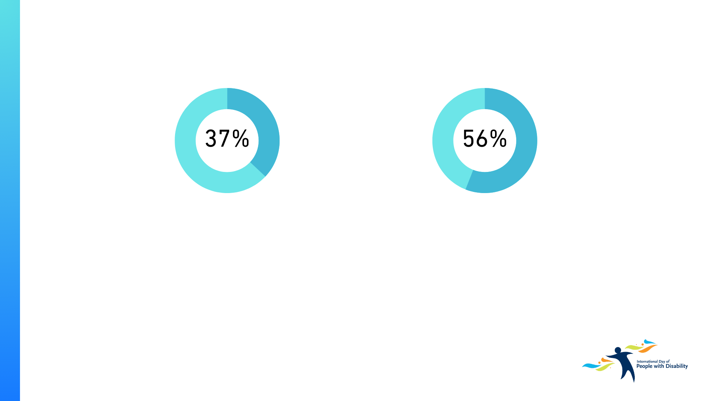
Disability in Australia cont.
Around 1 in 3 people with disability have severe or profound disability.
56% of people with disability aged 15-64 have a job.
Source: Disability, Ageing and Carers, Australia survey 2022, Australian Bureau of Statistics www.abs.gov.au/disability

Slide 6
How to get involved
Organise an IDPwD event
Take part in an IDPwD event
Take action
You can help break down barriers and promote inclusion by encouraging your school, workplace, or community group to organise an IDPwD event on or around 3 December.
You can find resources to help you organise your IDPwD event at: www.idpwd.gov.au/collections/event-information-kits
Connect with your local community, including people with disability, their families and carers, by taking part in an IDPwD event on or around 3 December.
You can find events in your local area in the IDPwD events calendar: www.idpwd.gov.au/events/events-calendar
IDPwD is a good time to make a commitment in your organisation, workplace or community group to:
develop a new disability action plan
support a local disability organisation
encourage conversations in your community, school, workplace, or with family and friends about disability inclusion and accessibility.
To help talk about disability, check out: www.idpwd.gov.au/resources/community-conversation-guide

Slide 7
How to get involved cont.
Read, watch or listen
Share your own story
Help spread the word
Not all disability is the same and everyone’s experience is different.
Learning more about people with disability can help us all reflect on attitudes and beliefs.
You can find stories from the disability community at: www.idpwd.gov.au/stories
If you are a person with lived experience of disability, you may wish to share your own story about your personal experiences, achievements or challenges.
If you’re interested in sharing your story, you can fill out this form: www.idpwd.gov.au/stories/share-your-personal-story
Social media is a great way to raise awareness and show your support for IDPwD.
Share messages of inclusion and diversity on your networks.
For social media key messages, posts and graphics, visit www.idpwd.gov.au/resources

Slide 8
Thank you for supporting IDPwD

